Slide 1

Ensemble Learning

Slide 2
Ensemble Learning
Ensemble methods is a machine learning technique that combines several base models in order to produce one optimal predictive model
Ensemble learning is a general meta approach to machine learning that seeks better predictive performance by combining the predictions from multiple models.
Ensemble learning is the process by which multiple models, such as classifiers or experts, are strategically generated and combined to solve a particular computational intelligence problem.
Ensemble learning is primarily used to improve the (classification, prediction, function approximation, etc.) performance of a model, or reduce the likelihood of an unfortunate selection of a poor one.

Slide 3
Example
Suppose you are a movie director and you have created a short movie on a very important and interesting topic.
Now, you want to take preliminary feedback (ratings) on the movie before making it public.
What are the possible ways by which you can do that?
You may ask one of your friends to rate the movie for you.
Another way could be by asking 5 colleagues of yours to rate the movie.
How about asking 50 people to rate the movie?

Slide 4
Ensemble Learning Methods
The following are the most popular ensemble learning methods i.e. the methods for combining the predictions from different models −
Bagging
Boosting
Voting

Slide 5
Bagging Ensemble Algorithms
1
The following are three bagging ensemble algorithms −
Bagged Decision Tree
Random Forest
Boosting Ensemble Algorithms
2
The followings are the two most common boosting ensemble algorithms −
AdaBoost
Stochastic Gradient Boosting

Slide 6
Bagging
BAGGing, or Bootstrap AGGregating - BAGGing gets its name because it combines Bootstrapping and Aggregation to form one ensemble model.
Given a sample of data, multiple bootstrapped subsamples are pulled.
A Decision Tree is formed on each of the bootstrapped subsamples.
After each subsample Decision Tree has been formed, an algorithm is used to aggregate over the Decision Trees to form the most efficient predictor.

Slide 7
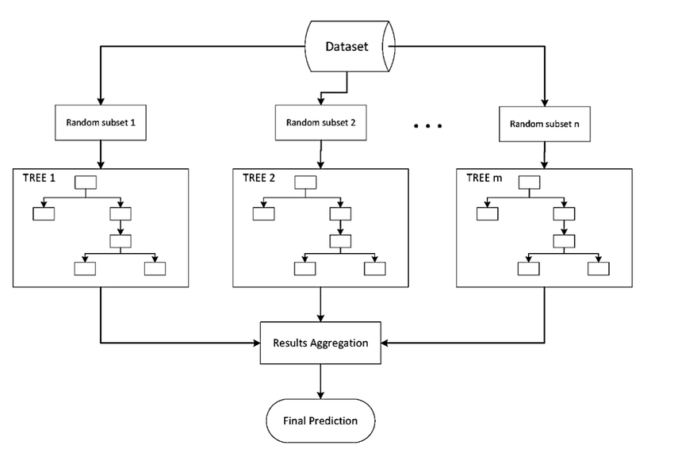

Slide 8
Random Forest
Random Forest Models can be thought of as BAGGing, with a slight tweak.
When deciding where to split and how to make decisions, BAGGed Decision Trees have the full disposal of features to choose from.
Therefore, although the bootstrapped samples may be slightly different, the data is largely going to break off at the same features throughout each model.
In contrary, Random Forest models decide where to split based on a random selection of features.
Rather than splitting at similar features at each node throughout, Random Forest models implement a level of differentiation because each tree will split based on different features.
This level of differentiation provides a greater ensemble to aggregate over, ergo producing a more accurate predictor.

Slide 9
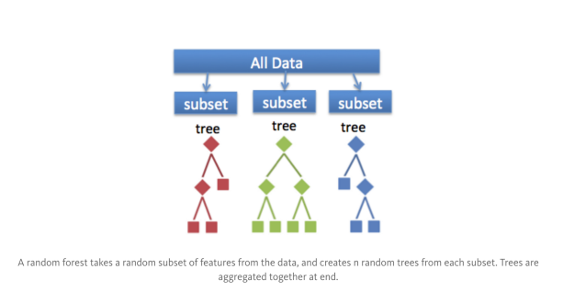

Slide 10
